Slide 1





BUBBLE SORT
VS
MERGE SORT
PREPARED
BY:
HARITH
(24003426)
EMIR
(24003510)
IDRIS
24003318
ZAKWAN
(24003466)

Slide 2



TODAY'S AGENDA
INTRODUCTION TO SORTING ALGORITHMS
BUBBLE SORT
MERGE SORT
APP INTERFACE SCREENSHOTS
SIDE BY SIDE COMPARISONS

Slide 3


INTRODUCTION TO
ALGORITHMS
Algorithms are step-by-step procedures used to solve problems or perform tasks.
Sorting algorithms arrange data in a specific order (e.g., ascending or descending).
Sorting is fundamental in searching, data processing, and optimization tasks.
Choosing the right sorting algorithm affects:
Efficiency (speed)
Memory usage
Scalability
This project compares two sorting algorithms:
Bubble Sort – simple, intuitive, but less efficient
Merge Sort – more complex, but highly efficient for large data

Slide 4




BUBBLE SORT
A SIMPLE COMPARISON-BASED SORTING ALGORITHM
REPEATEDLY COMPARES AND SWAPS ADJACENT ELEMENTS IF THEY ARE IN THE WRONG ORDER
PROCESS REPEATS UNTIL THE LIST IS SORTED
BEST CASE TIME COMPLEXITY: O(N) (ALREADY SORTED)
WORST/AVERAGE CASE: O(N²) (MANY SWAPS NEEDED)
SPACE COMPLEXITY: O(1) – IN-PLACE SORTING
EASY TO IMPLEMENT, BUT INEFFICIENT FOR LARGE DATASETS

Slide 5
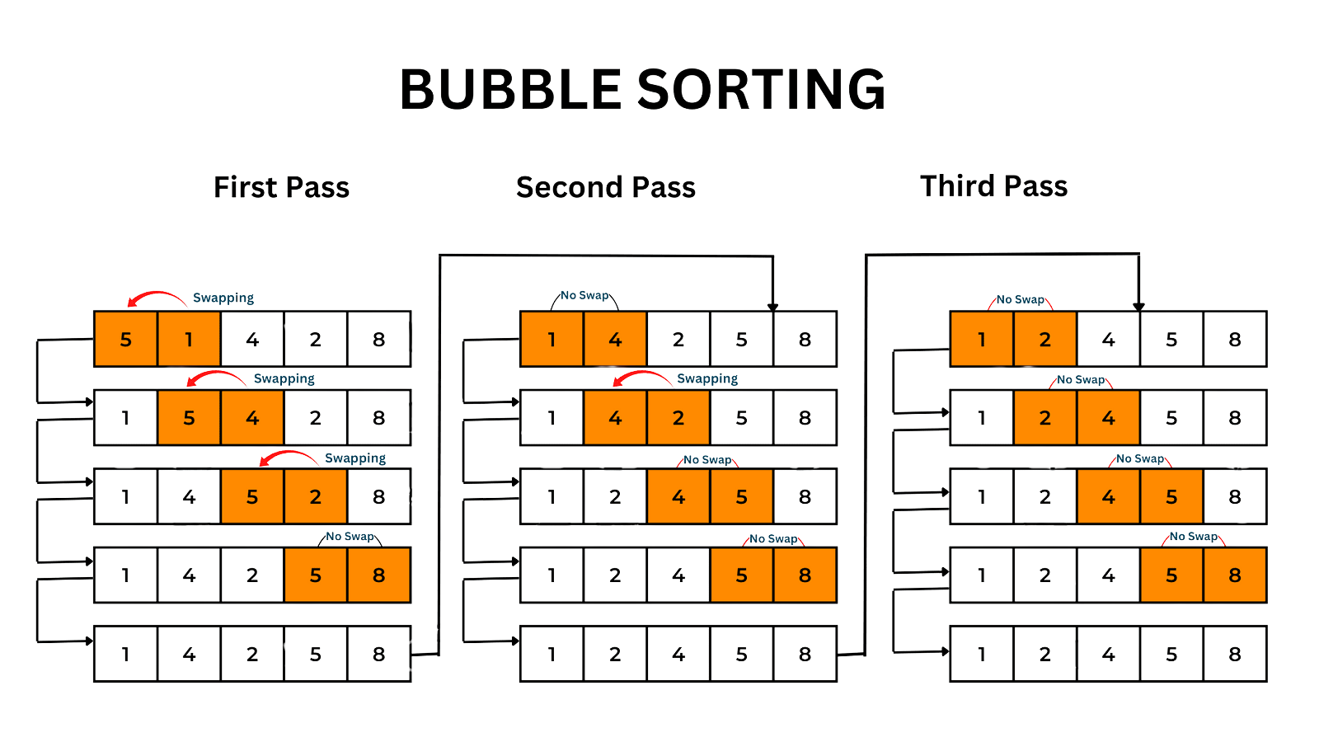

Slide 6
MERGE SORT
A DIVIDE AND CONQUER ALGORITHM
RECURSIVELY DIVIDES THE LIST INTO HALVES, SORTS THEM, THEN MERGES THEM BACK
ALWAYS FOLLOWS THE SAME RECURSIVE STRUCTURE
TIME COMPLEXITY (ALL CASES): O(N LOG N)
SPACE COMPLEXITY: O(N) – USES ADDITIONAL MEMORY FOR MERGING
STABLE AND EFFICIENT, ESPECIALLY FOR LARGE DATASETS
PERFORMS WELL EVEN WITH UNSORTED OR LARGE INPUTS

Slide 7
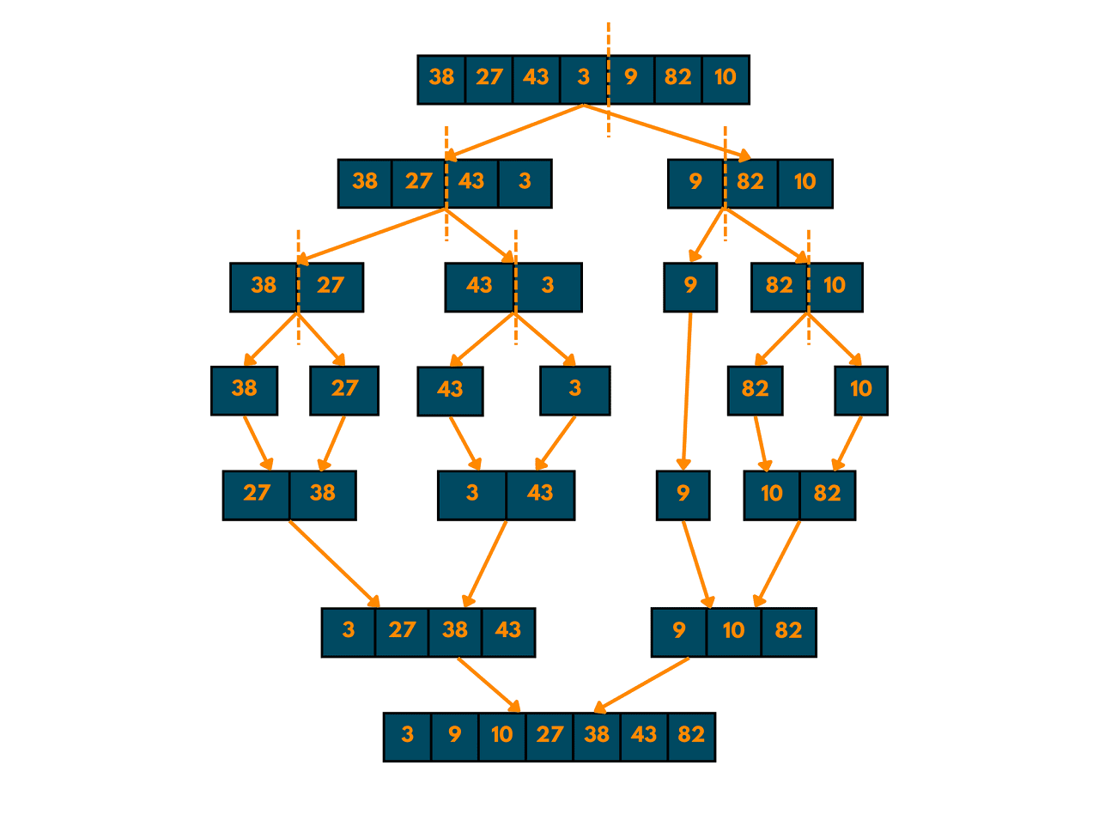
MERGE SORT

Slide 8
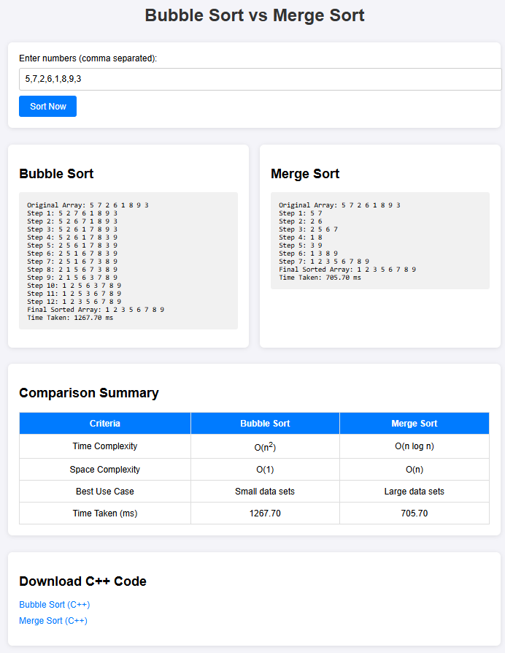




WEBSITE SCREENSHOT

Slide 9

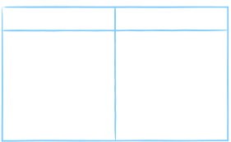
SIDE-BY-SIDE COMPARISONS
BUBBLE SORT
MERGE SORT
TIME COMPLEXITY:O(N^2)
SPACE COMPLEXITY:O(1)
STABILITY:STABLE
EASE OF CODING:EASY
USE CASE:SMALL DATASET
TIME COMPLEXITY: O(N LOG N)
SPACE COMPLEXITY:O(N)
STABILITY:STABLE
EASE OF CODING:MODERATE
USE CASE:LARGE DATASET

Slide 10
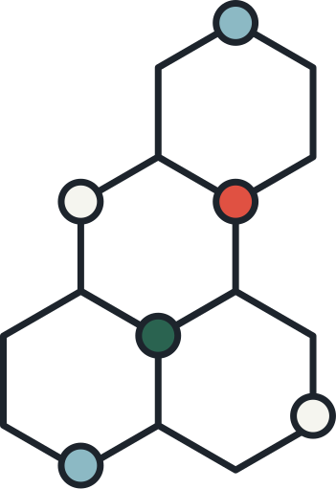


THANK YOU!

